Slide 1

Net.Art Process Book
By Brandy white

Slide 2
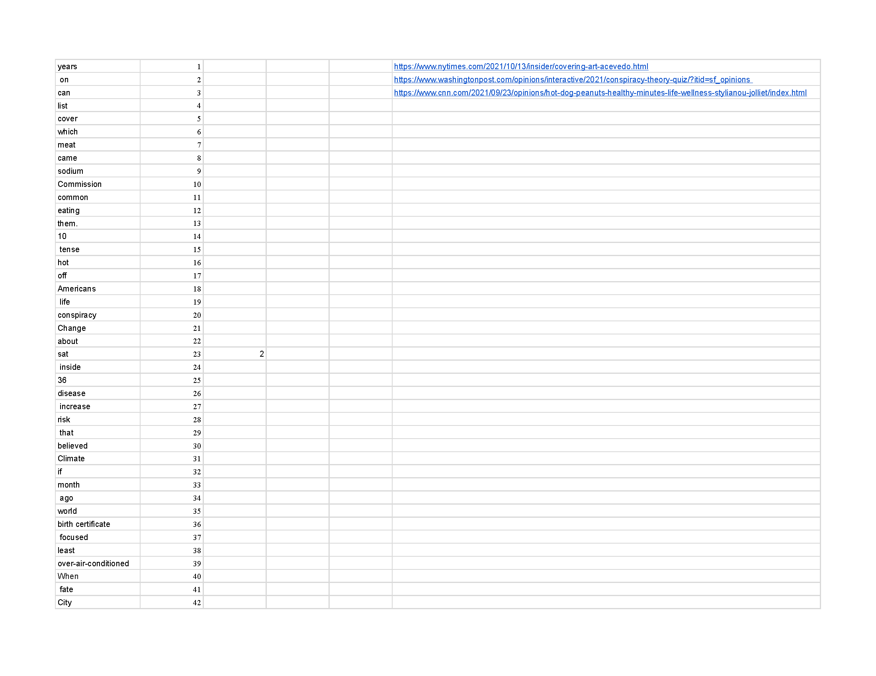
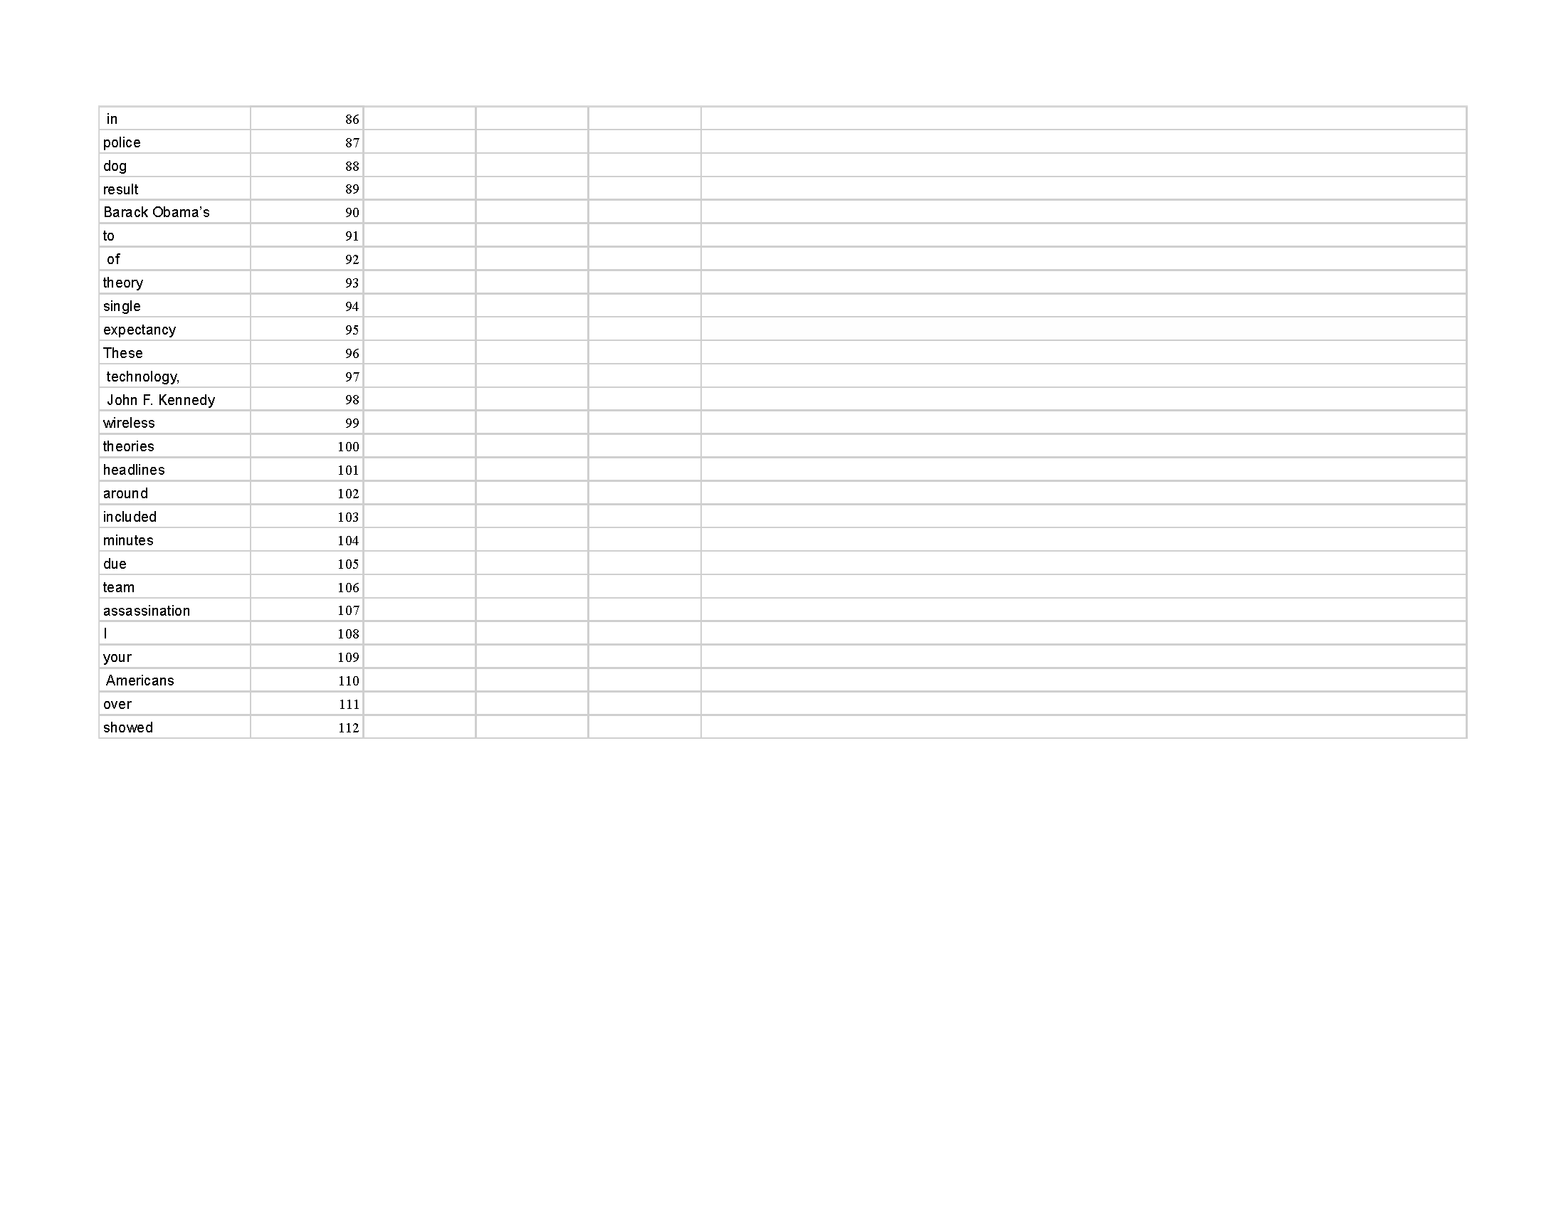
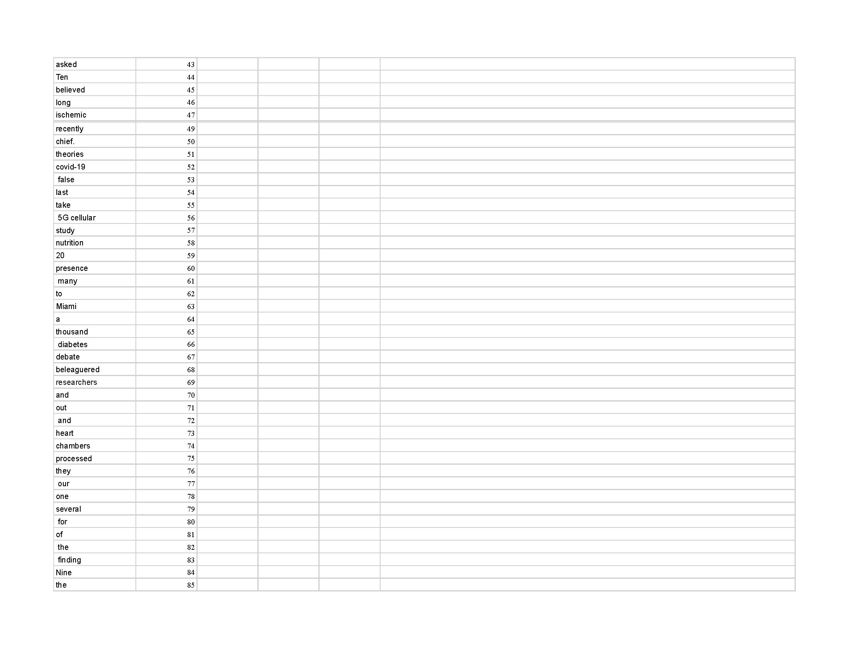
Word Game
These are the Words that I placed into the Excel Sheet and used Random.org to create the Word list for my Net.Art Painting

Slide 3
News Articles
- CNN
https://www.cnn.com/2021/09/23/opinions/hot-dog-peanuts-healthy-minutes-life-wellness-stylianou-jolliet/index.html
- https://www.washingtonpost.com/opinions/interactive/2021/conspiracy-theory-quiz/?itid=sf_opinions
- https://www.nytimes.com/2021/10/13/insider/covering-art-acevedo.html

Slide 4
Sentence to Work with
- 10 Tense hot off Americans life conspiracy change.

Slide 5
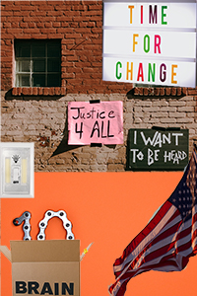
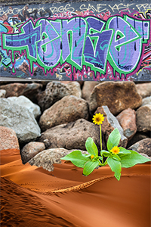
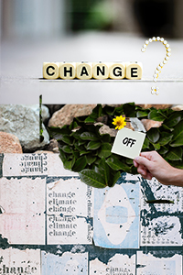
Collage

Slide 6
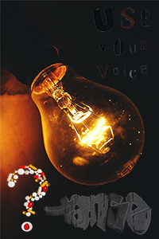
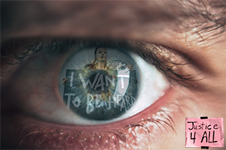
Collage

Slide 7
Image Sources
10 - Photo by Miguel Á. Padriñán from Pexels
Waving flag - Photo by Sawyer Sutton from Pexels
Statue of Liberty - Photo by Pixabay from Pexels
Tense - "TENSE" by JOHN19701970 is marked with CC0 1.0
Lightbulb - Photo by ARUNODHAI VINOD from Pexels
Desert - Photo by Pixabay from Pexels
Off Switch - Photo by Tara Winstead from Pexels
Off - Photo by Oleg Magni from Pexels
Life - Photo by Nacho Juárez from Pexels
Life of Now - Photo by Elina Fairytale from Pexels
Justice - Photo by RODNAE Productions from Pexels
Want to be heard - Photo by RODNAE Productions from Pexels
Time for Change - Photo by Alexas Fotos from Pexels
Climate Change - Photo by Alexas Fotos from Pexels
Change - Photo by Nothing Ahead from Pexels
Use - Photo by Polina Kovaleva from Pexels
Brain - Photo by SHVETS production from Pexels
Eye - Photo by Victor Freitas from Pexels
Question Mark - Photo by Anna Shvets from Pexels
Pill Questions - Photo by Anna Shvets from Pexels

